Slide 1
TAMS Training
Jonathan Sullivan and Jodi Rose

Slide 2
Processing the COM150

Slide 3
TAMS – Processing the COM150
Objectives
This job-aid will show you how to:
Process the COM150 communication
Print the COM150 report

Slide 4
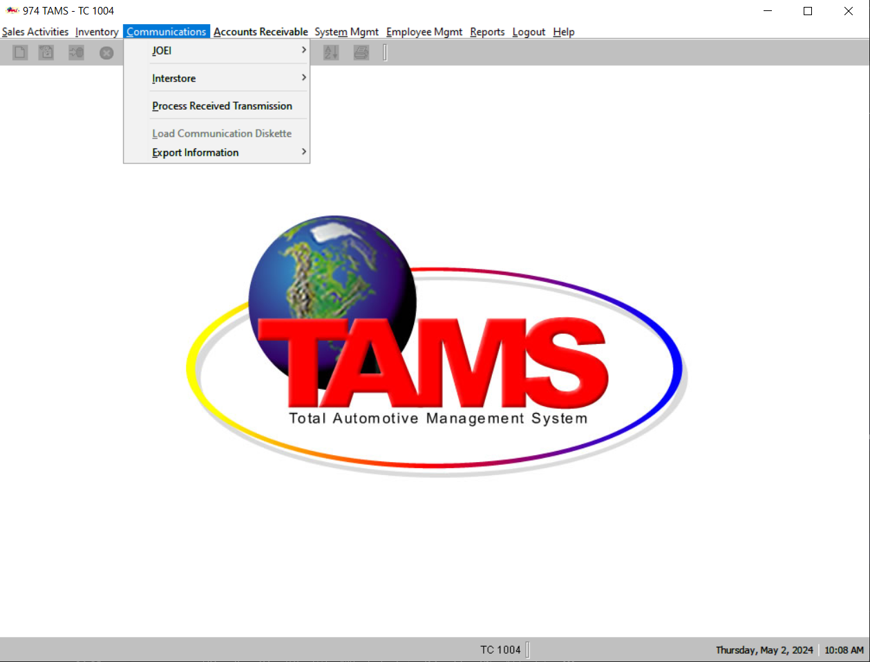
TAMS – Processing the COM150
1
On the TAMS Back Office screen, from the “Communications” menu, select “Process Received Transmission”
Check the “Receipts” field and click “Process”
Enter the number of copies of the COM150 report to print and click “OK”
Select the printer from the drop-down menu and click “OK”
The COM150 report will process and print within a few minutes
1
2
3
4
5

Slide 5
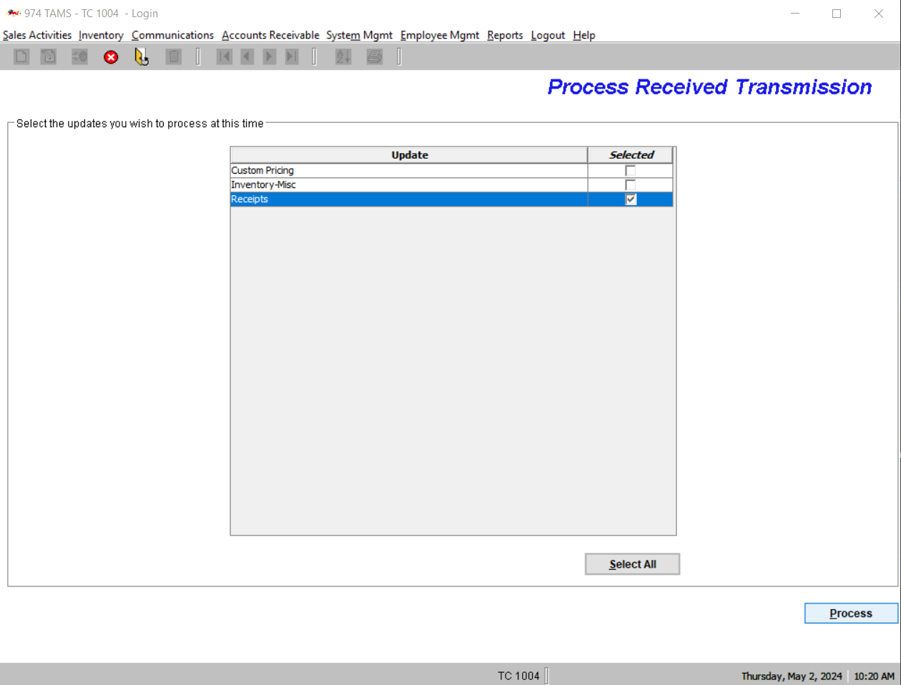
TAMS – Processing the COM150
1
On the TAMS Back Office screen, from the “Communications” menu, select “Process Received Transmission”
Check the “Receipts” field and click “Process”
Enter the number of copies of the COM150 report to print and click “OK”
Select the printer from the drop-down menu and click “OK”
The COM150 report will process and print within a few minutes
2
3
4
5
2

Slide 6
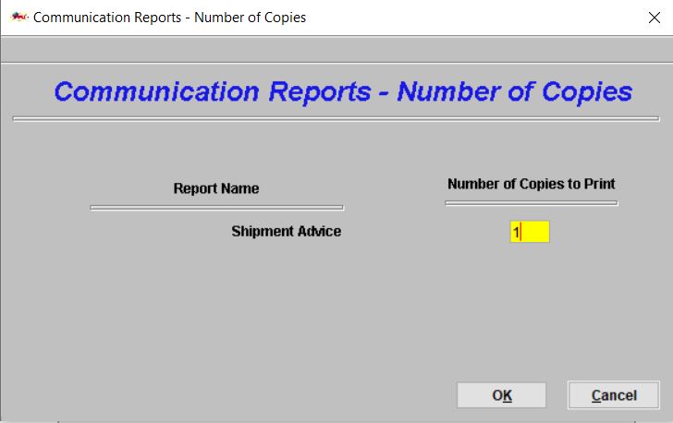
TAMS – Processing the COM150
1
On the TAMS Back Office screen, from the “Communications” menu, select “Process Received Transmission”
Check the “Receipts” field and click “Process”
Enter the number of copies of the COM150 report to print and click “OK”
Select the printer from the drop-down menu and click “OK”
The COM150 report will process and print within a few minutes
2
3
4
3
5

Slide 7
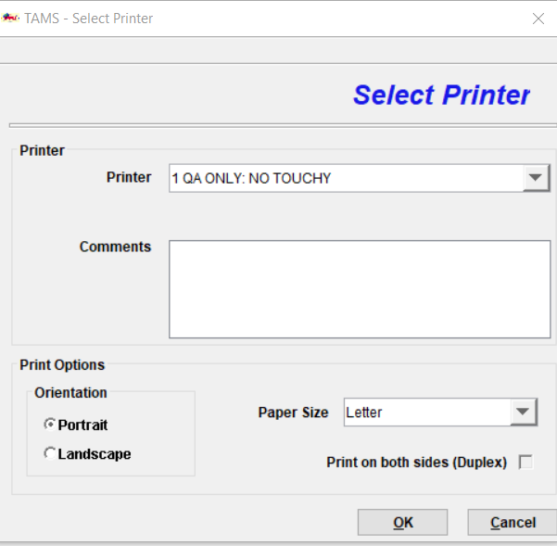
TAMS – Processing the COM150
1
On the TAMS Back Office screen, from the “Communications” menu, select “Process Received Transmission”
Check the “Receipts” field and click “Process”
Enter the number of copies of the COM150 report to print and click “OK”
Select the printer from the drop-down menu and click “OK”
The COM150 report will process and print within a few minutes
2
3
4
5
4

Slide 8
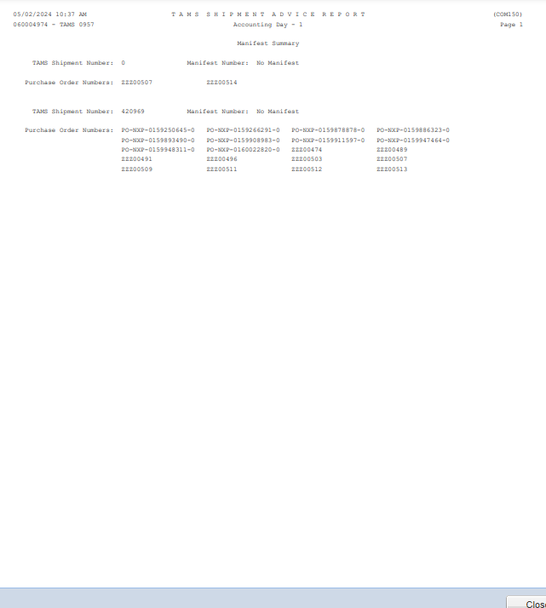
TAMS – Processing the COM150
1
On the TAMS Back Office screen, from the “Communications” menu, select “Process Received Transmission”
Check the “Receipts” field and click “Process”
Enter the number of copies of the COM150 report to print and click “OK”
Select the printer from the drop-down menu and click “OK”
The COM150 report will process and print within a few minutes
2
3
4
5
5

