Slide 1
TAMS Training
Jonathan Sullivan and Jodi Rose

Slide 2
Resetting Employee Passwords
NOTE: Only Associate stores can perform this task. Corporate stores must contact their regional office for any update to employee settings.
For assistance, call TAMS Support at: 1-800-361-8977

Slide 3
TAMS – Resetting Employee Passwords
Objectives
This job-aid will show you how to:
Reset an employee password in TAMS

Slide 4
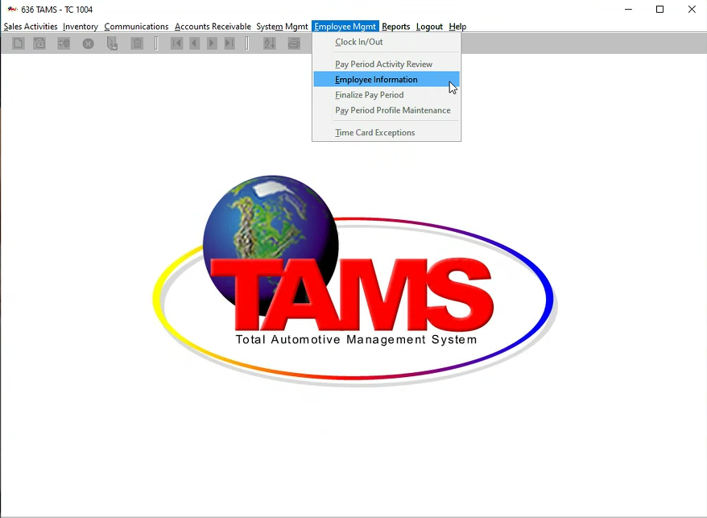
TAMS – Resetting Employee Passwords
On the TAMS Back Office screen, from the “Employee Mgmt” menu, select “Employee Information”
Enter the employee number in the “Employee” field and press “Enter”
Enter a temporary password in the “Employee Password” field
Click the “Save” button from the Toolbar
Note: After saving, the “Expires in Days” field will automatically populate to 90 days
Click the “Close” button from the Toolbar
From the “Logout” menu, click “Logout/in”
Note: This step is necessary for the changes to take effect in TAMS
1
1
2
3
4
5
6

Slide 5
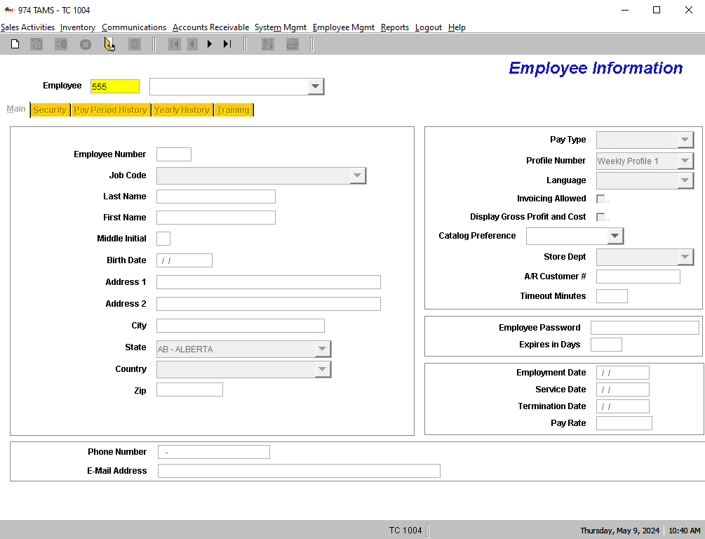
TAMS – Resetting Employee Passwords
On the TAMS Back Office screen, from the “Employee Mgmt” menu, select “Employee Information”
Enter the employee number in the “Employee” field and press “Enter”
Enter a temporary password in the “Employee Password” field
Click the “Save” button from the Toolbar
Note: After saving, the “Expires in Days” field will automatically populate to 90 days
Click the “Close” button from the Toolbar
From the “Logout” menu, click “Logout/in”
Note: This step is necessary for the changes to take effect in TAMS
1
2
2
3
4
5
6

Slide 6
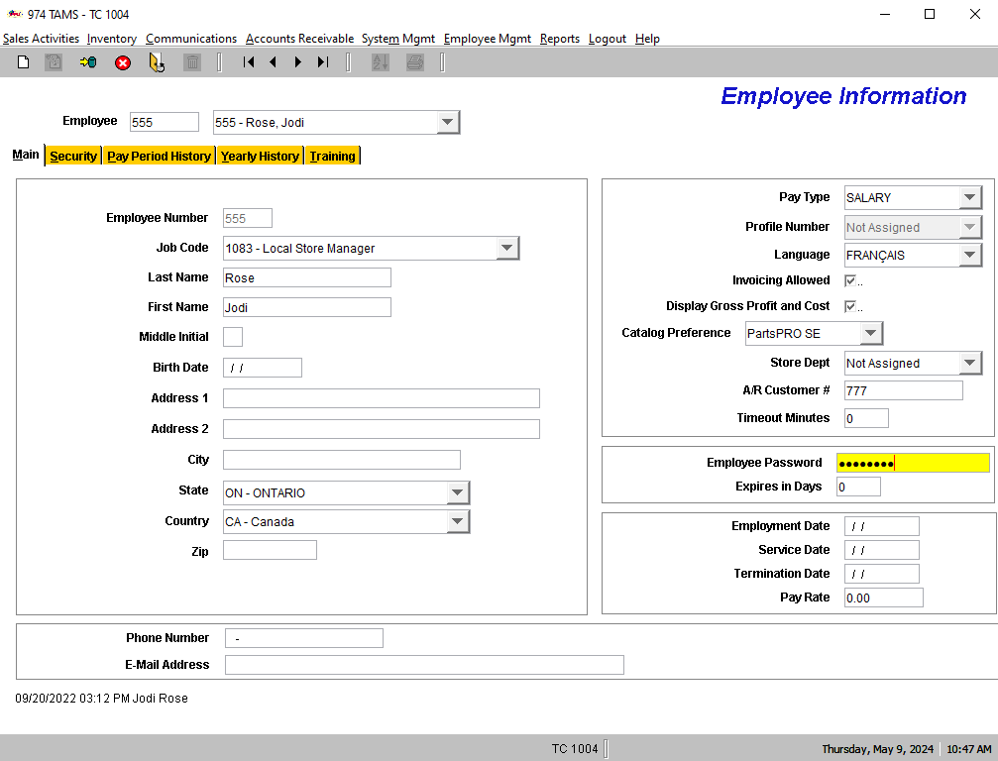
TAMS – Resetting Employee Passwords
On the TAMS Back Office screen, from the “Employee Mgmt” menu, select “Employee Information”
Enter the employee number in the “Employee” field and press “Enter”
Enter a temporary password in the “Employee Password” field
Click the “Save” button from the Toolbar
Note: After saving, the “Expires in Days” field will automatically populate to 90 days
Click the “Close” button from the Toolbar
From the “Logout” menu, click “Logout/in”
Note: This step is necessary for the changes to take effect in TAMS
1
2
3
4
3
5
6

Slide 7
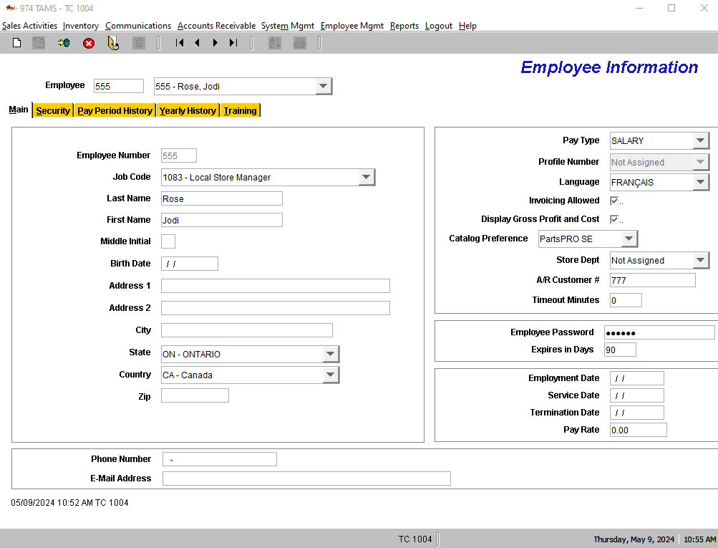
TAMS – Resetting Employee Passwords
On the TAMS Back Office screen, from the “Employee Mgmt” menu, select “Employee Information”
Enter the employee number in the “Employee” field and press “Enter”
Enter a temporary password in the “Employee Password” field
Click the “Save” button from the Toolbar
Note: After saving, the “Expires in Days” field will automatically populate to 90 days
Click the “Close” button from the Toolbar
From the “Logout” menu, click “Logout/in”
Note: This step is necessary for the changes to take effect in TAMS
1
4
2
3
4
5
6

Slide 8
TAMS – Resetting Employee Passwords
On the TAMS Back Office screen, from the “Employee Mgmt” menu, select “Employee Information”
Enter the employee number in the “Employee” field and press “Enter”
Enter a temporary password in the “Employee Password” field
Click the “Save” button from the Toolbar
Note: After saving, the “Expires in Days” field will automatically populate to 90 days
Click the “Close” button from the Toolbar
From the “Logout” menu, click “Logout/in”
Note: This step is necessary for the changes to take effect in TAMS
1
5
2
3
4
5
6

Slide 9

TAMS – Resetting Employee Passwords
On the TAMS Back Office screen, from the “Employee Mgmt” menu, select “Employee Information”
Enter the employee number in the “Employee” field and press “Enter”
Enter a temporary password in the “Employee Password” field
Click the “Save” button from the Toolbar
Note: After saving, the “Expires in Days” field will automatically populate to 90 days
Click the “Close” button from the Toolbar
From the “Logout” menu, click “Logout/in”
Note: This step is necessary for the changes to take effect in TAMS
1
6
2
3
4
5
6

Slide 10
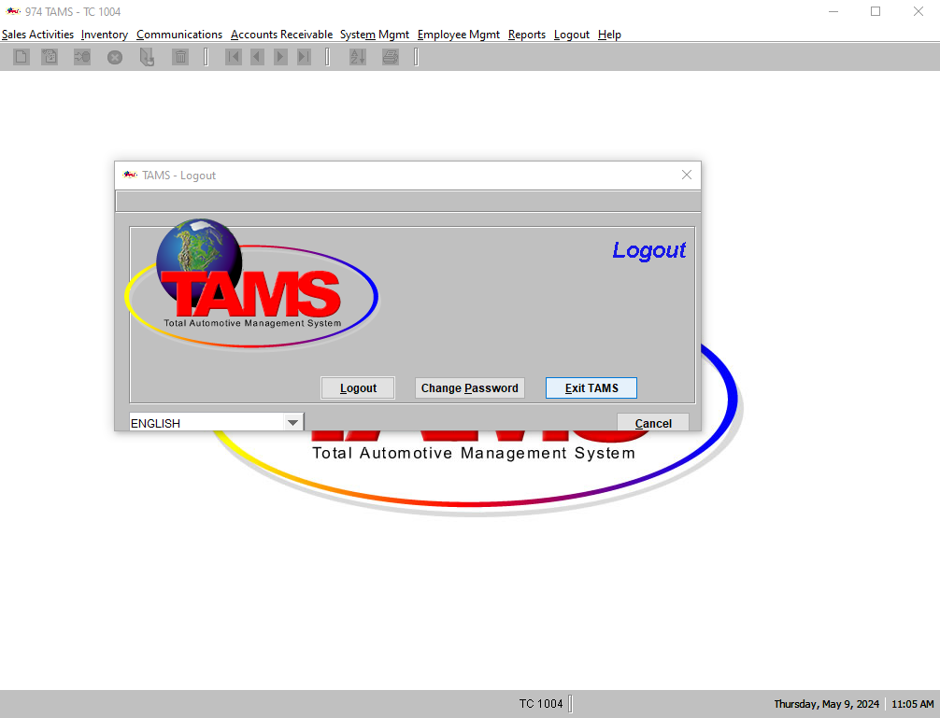
TAMS – Resetting Employee Passwords
7
Click “Exit TAMS”
Note: TAMS must also be exited for the new password to take effect
Click “Yes” on the pop-up window
Double click the TAMS II graphical icon located on the store PC desktop
The employee logs in with their employee number and temporary password
Click ”OK” on the “Warning” pop up window
Enter and confirm a new password:
Minimum 6 characters
Must contain at least one letter and one number
Special characters (such as “!@$%”) must not be used
8
9
7
10
11
12

Slide 11
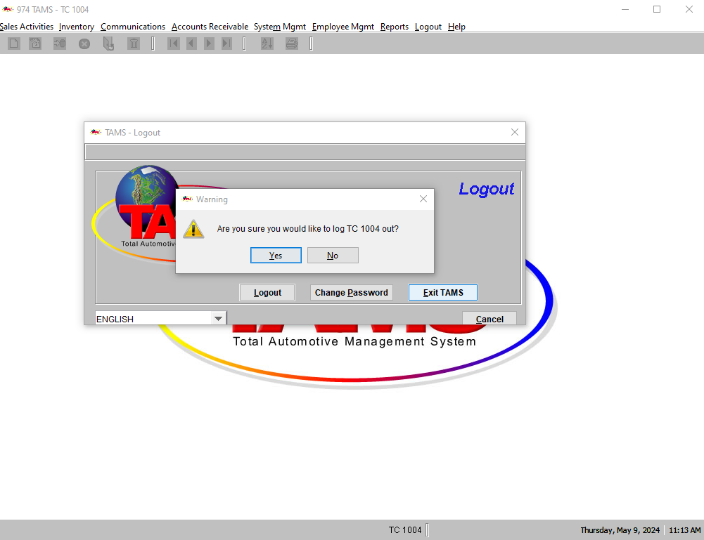
TAMS – Resetting Employee Passwords
7
Click “Exit TAMS”
Note: TAMS must also be exited for the new password to take effect
Click “Yes” on the pop-up window
Double click the TAMS II graphical icon located on the store PC desktop
The employee logs in with their employee number and temporary password
Click ”OK” on the “Warning” pop up window
Enter and confirm a new password:
Minimum 6 characters
Must contain at least one letter and one number
Special characters (such as “!@$%”) must not be used
8
9
10
8
11
12

Slide 12
TAMS – Resetting Employee Passwords
7
Click “Exit TAMS”
Note: TAMS must also be exited for the new password to take effect
Click “Yes” on the pop-up window
Double click the TAMS II graphical icon located on the store PC desktop
The employee logs in with their employee number and temporary password
Click ”OK” on the “Warning” pop up window
Enter and confirm a new password:
Minimum 6 characters
Must contain at least one letter and one number
Special characters (such as “!@$%”) must not be used
8
9
10
11
9
12

Slide 13
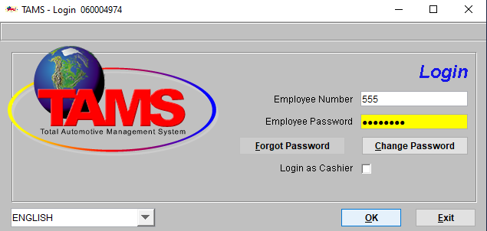
TAMS – Resetting Employee Passwords
7
Click “Exit TAMS”
Note: TAMS must also be exited for the new password to take effect
Click “Yes” on the pop-up window
Double click the TAMS II graphical icon located on the store PC desktop
The employee logs in with their employee number and temporary password
Click ”OK” on the “Warning” pop up window
Enter and confirm a new password:
Minimum 6 characters
Must contain at least one letter and one number
Special characters (such as “!@$%”) must not be used
8
9
10
11
10
12

Slide 14
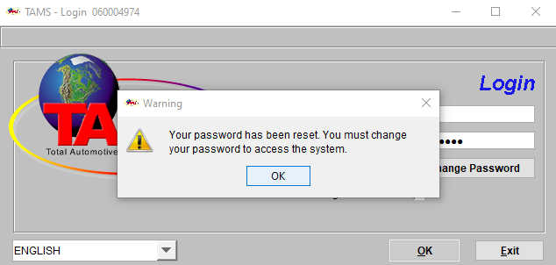
TAMS – Resetting Employee Passwords
7
Click “Exit TAMS”
Note: TAMS must also be exited for the new password to take effect
Click “Yes” on the pop-up window
Double click the TAMS II graphical icon located on the store PC desktop
The employee logs in with their employee number and temporary password
Click ”OK” on the “Warning” pop up window
Enter and confirm a new password:
Minimum 6 characters
Must contain at least one letter and one number
Special characters (such as “!@$%”) must not be used
8
9
10
11
11
12

Slide 15
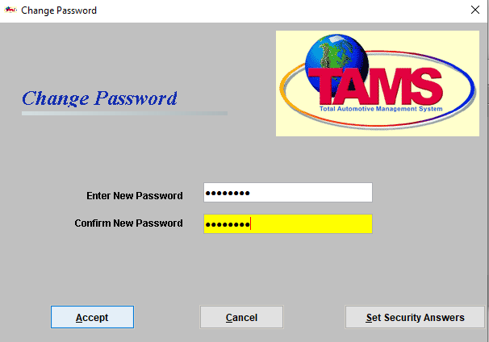
TAMS – Resetting Employee Passwords
7
Click “Exit TAMS”
Note: TAMS must also be exited for the new password to take effect
Click “Yes” on the pop-up window
Double click the TAMS II graphical icon located on the store PC desktop
The employee logs in with their employee number and temporary password
Click ”OK” on the “Warning” pop up window
Enter and confirm a new password:
Minimum 6 characters
Must contain at least one letter and one number
Special characters (such as “!@$%”) must not be used
8
9
10
11
12
12

Slide 16
TAMS – Resetting Employee Passwords
Click “Accept”
Click “OK”
12
13
12

Slide 17
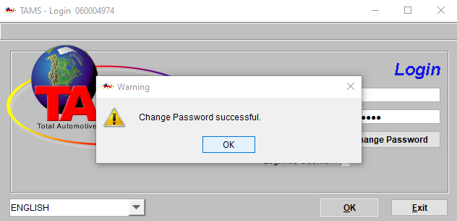
TAMS – Resetting Employee Passwords
Click “Accept”
Click “OK”
12
13
13

